Slide 1

IoT Sensor Data Forecasting System
BVI3114 – TECHNOLOGY SYSTEM OPTIMIZATION 2
GROUP MEMBER :
Mohd Qamarul BIN ABDUL KADIR
MUHAMMAD HARIS IKHWAN BIN ROSMADI
MUHAMMAD FAKRUL DANIAL BIN NAZARI

Slide 2

Project Overview & Objectives
Overview
Objectives
Real-time IoT system using ESP32 and EMA
Forecasts sensor data via Google Apps Script
Visualized in Looker Studio
Collect live sensor data
Predict using EMA
Visualize in dashboard
Integrate cloud-based tools

Slide 3
System Architecture Diagram
Sensor
ESP32
Google Sheets
Mobile
Dashboard
Looker Studio
Apps Script

Slide 4
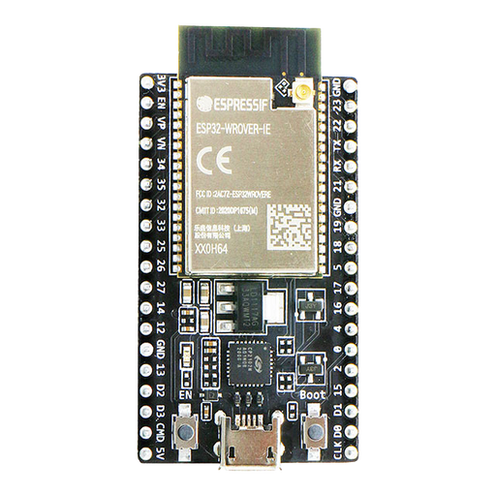
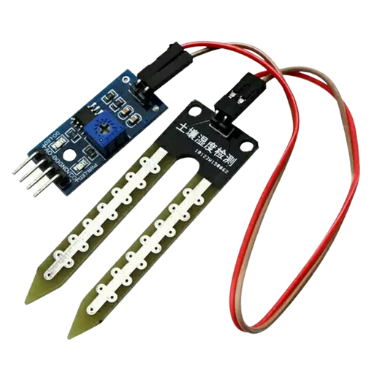
Hardware Components
ESP32
Moisture Sensor

Slide 5
Software Components
Google Sheets
Google Apps Script
Looker Studio
Arduino IDE

Slide 6
Forecasting Techniques Researched
Exponential Moving Average (EMA)
Weighted average favoring recent data
Faster response
Best for fluctuating sensor data

Slide 7
Selected Forecasting Algorithm (EMA)
Exponential Moving Average (EMA) Formula :
EMA_t = α * Value_t + (1 - α) * EMA_{t-1}
Why EMA :
Reacts to recent changes
Smooths out noise
Easy to implement

Slide 8
Google Apps Script Implementation
Key Functions
generateForecasts()
calculateEMA(values, smoothingFactor)
Example :
ema = α * value + (1 - α) * previous_ema

Slide 9

Forecast Data in Google Sheets
Sheets Used
Includes
SensorData: historical readings
Forecasts: predictions
Timestamp
Forecasted value
Upper/Lower bounds

Slide 10
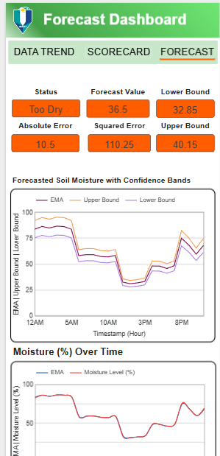
Looker Studio Dashboard
Visual
Historical & forecast data chart
Confidence intervals
Current reading
Forecast for next hour

Slide 11
Results & Observations
Forecast closely matches actual data
Smooth output with responsive prediction
EMA adapts well to trends

Slide 12
Challenges & Future Improvements
Challenges
Future
Wi-Fi stability
Rate limits in Apps Script
More sensors
Alert system

Slide 13
Q&A

Slide 14
Thank You

